Slide 1
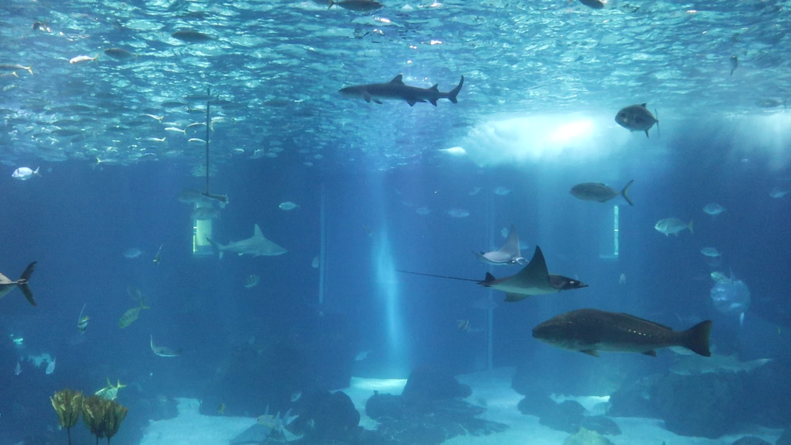
Fish Behavior Detection through Video Frames and Trajectories
Gonçalo Adolfo
Supervisors Prof. Alexandre Bernardino and Prof. H.Sofia Pinto
Instituto Superior Técnico, Universidade de Lisboa

Slide 2
Table of Contents
01
03
05
Motivation
Related Work
Results
why?
what has already been done
what performance was obtained
02
04
06
Objectives
Implementation
Conclusions
what?
how?
what performance was obtained

Slide 3
Motivation
Biologists, research, monitoring
Abnormal behaviors, explicit activities
1
Abnormal behaviors: disease, habitat integration, integration with other species
Underfeeding: aggressive behaviors
Overfeeding: food waste, water quality
2
3
Real time visual inspection
Camera installation
Lots of data

Slide 4
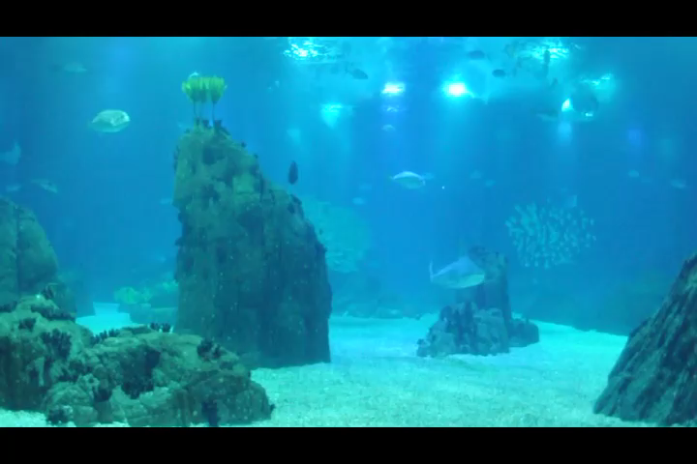
Objectives
Lisbon Oceanarium – Main Tank
Sharks, Manta Rays
Feeding
Interesting episodes and anomalies

Slide 5
Related Work
Detection, Tracking, Classification
Detection: background subtraction methods, YOLO
Tracking: position and color, Kalman Filter, color history, temporary tracks
Classification: linear regression
1
Abnormal Behavior Detection
Cascade of rules: motion features
velocity and turning angle dispersion
Clustering approaches: position-based
Classification: hierarchical classifier based on motion features
2
Activity Recognition (feeding)
Accelerometer data: rules/CNN
Aggregation Index
CNN, input image
3
Faltam refs

Slide 6
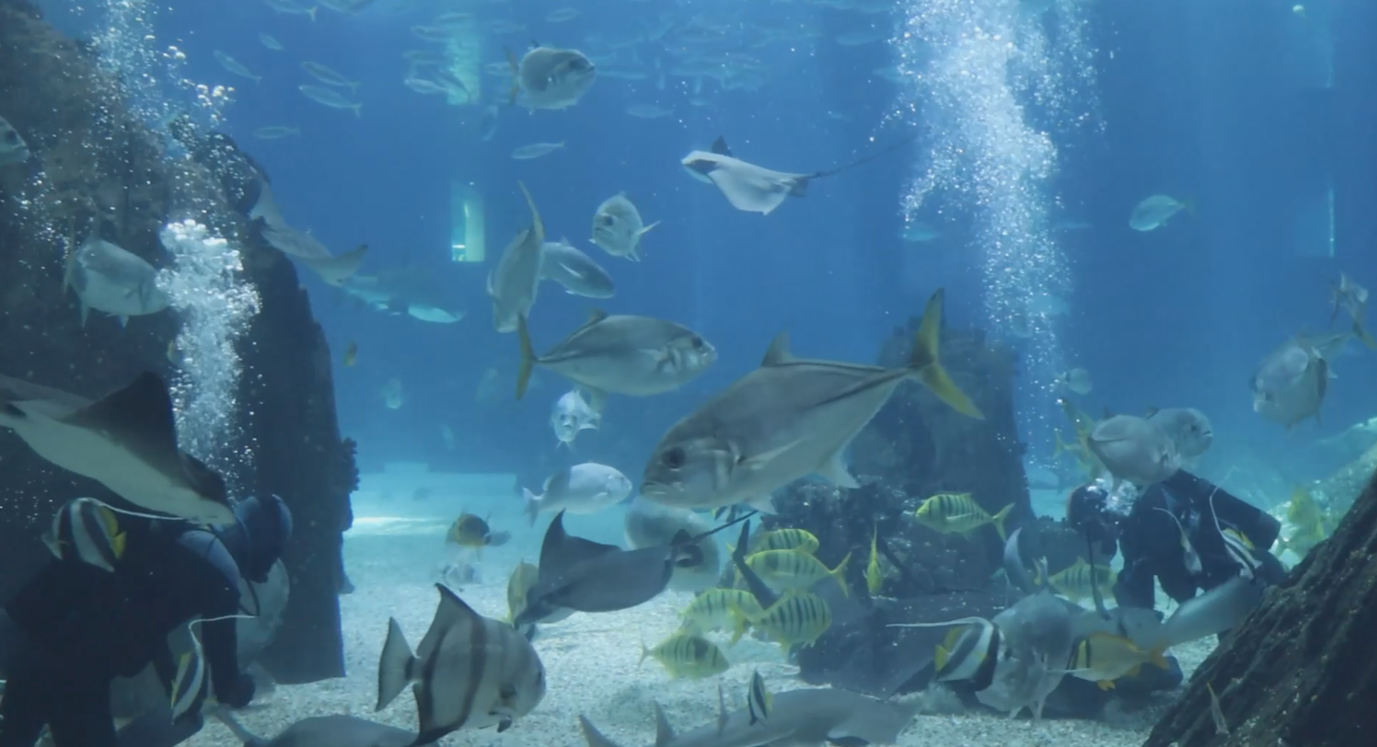
Implementation

Slide 7
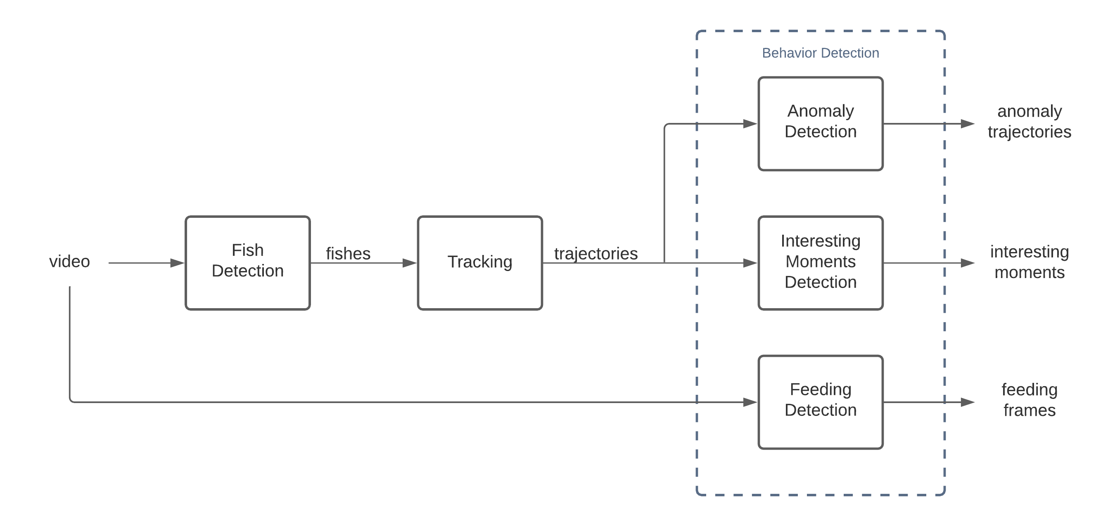
Methodology

Slide 8
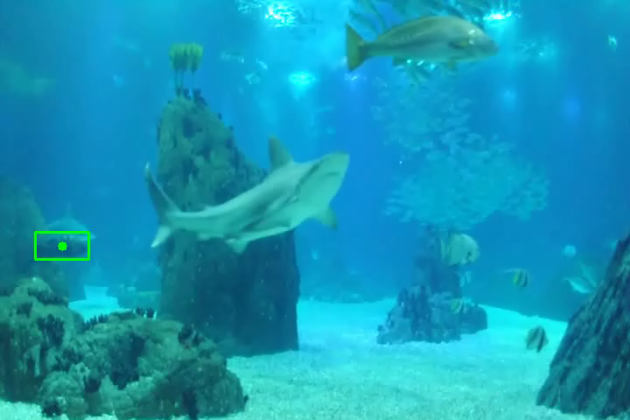
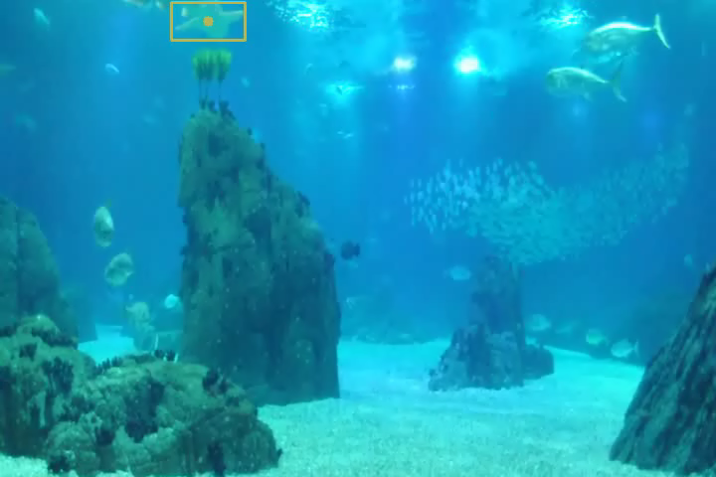
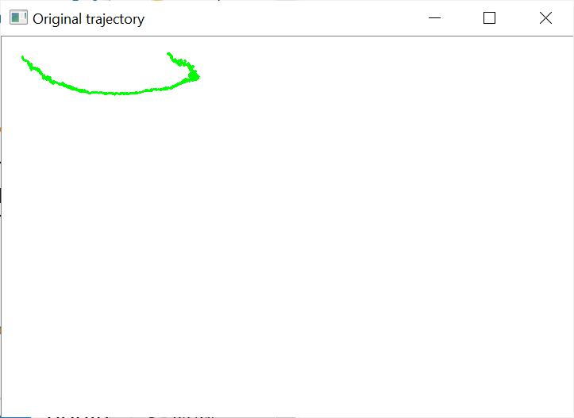
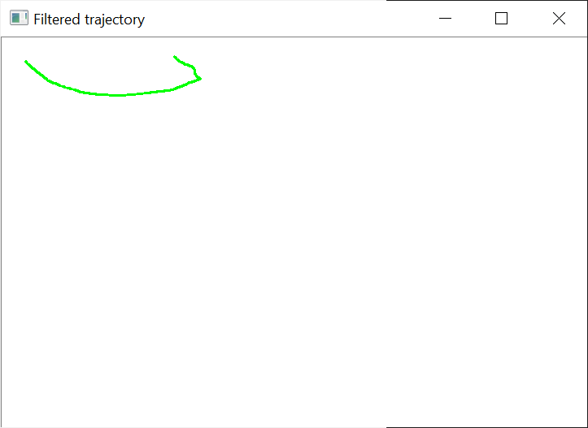
Trajectories Pre-Processing
Interpolation
Segmentation
Filtering

Slide 9
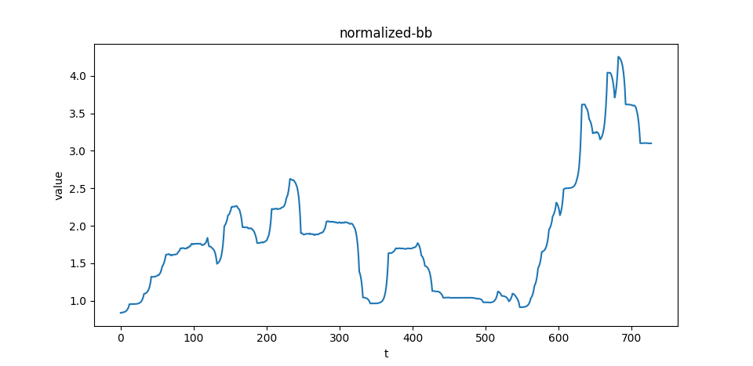
Feature Extraction
velocity
acceleration
curvature
regions
centered distance
turning angle
bounding box aspect ratio

Slide 10
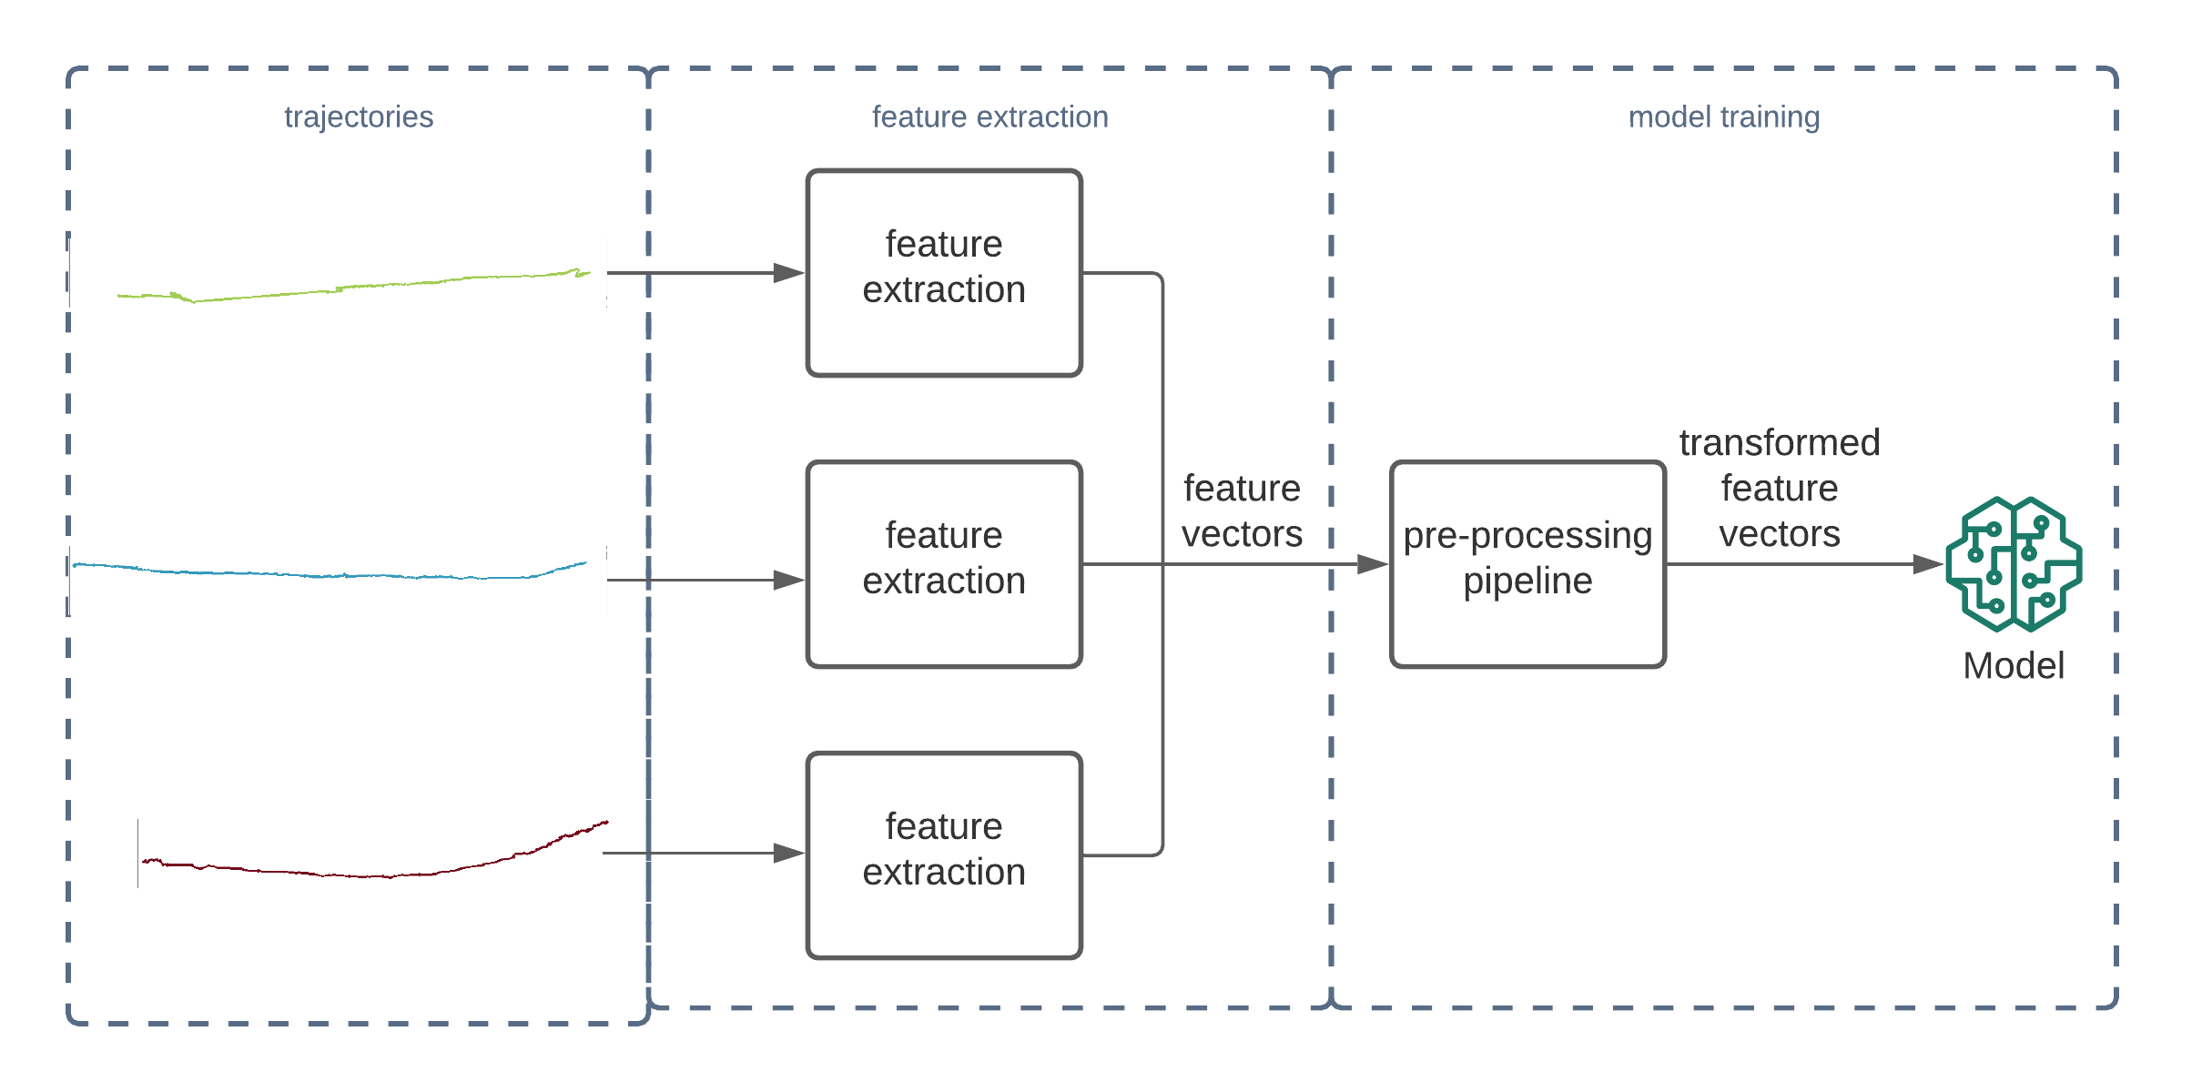
Interesting Moments - Classification
SVM, KNN
DT, RF
NB

Slide 11
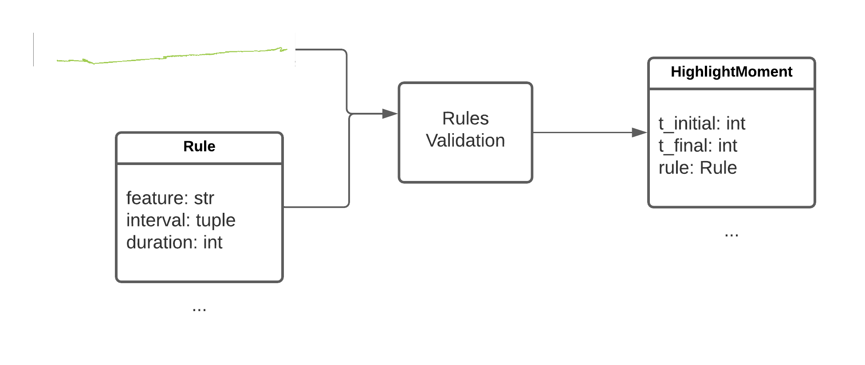
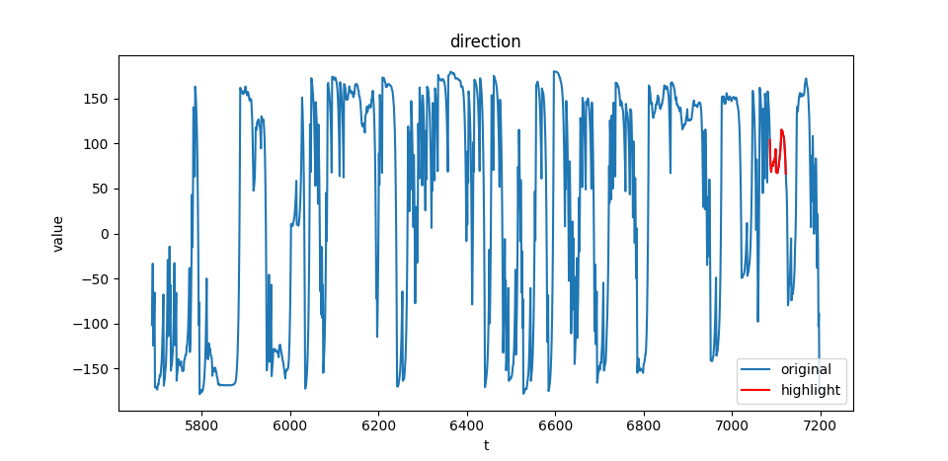
Interesting Moments - Rules Specification

Slide 12
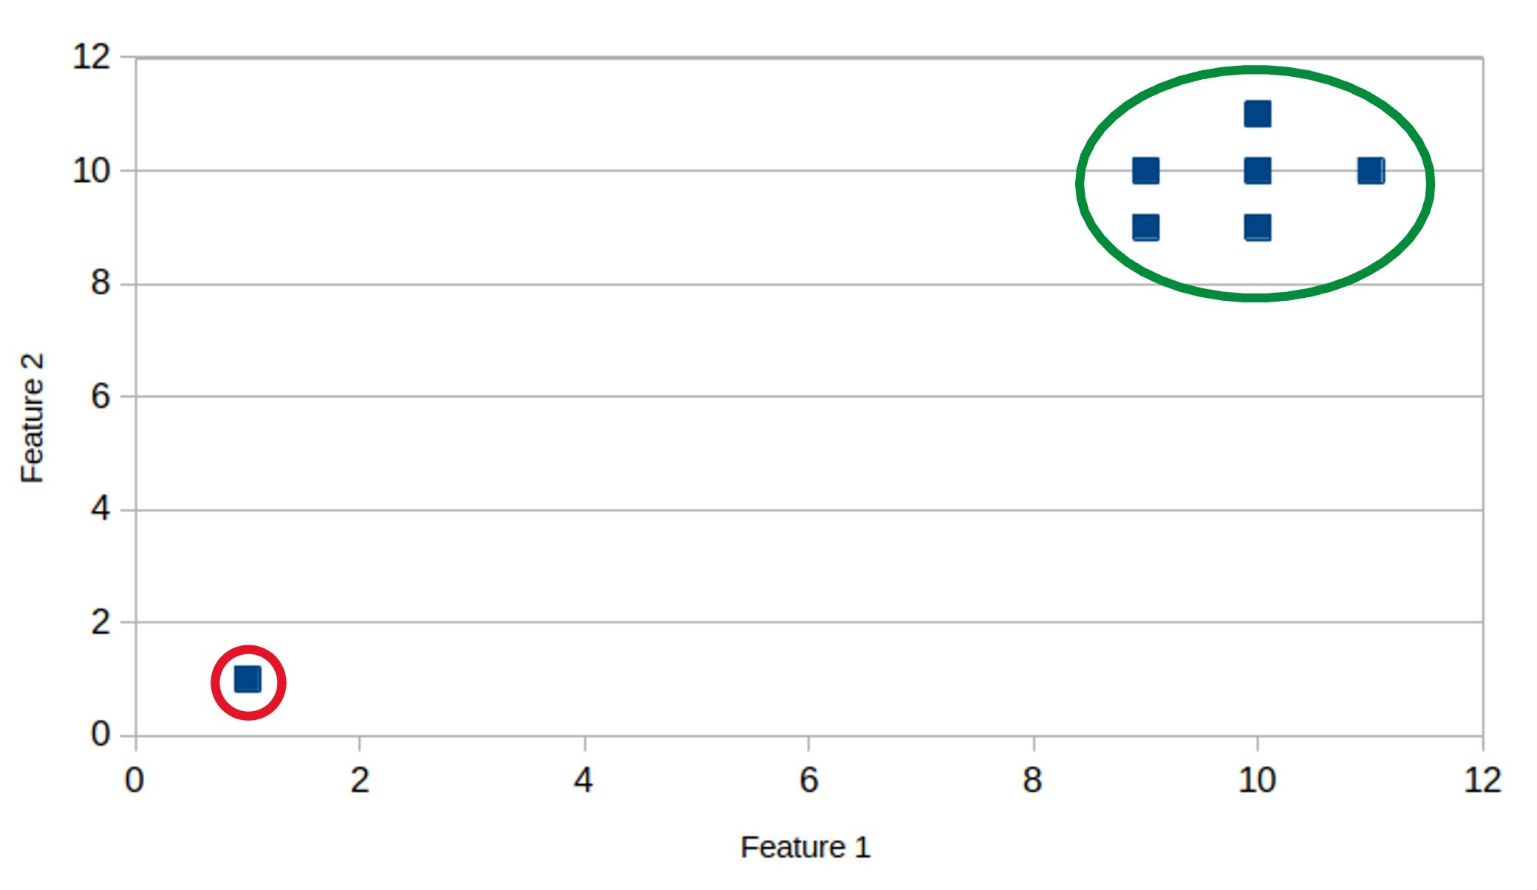
Anomaly Detection - Clustering
Two algorithms: KMeans, DBScan
KMeans needs the definition of a percentage threshold

Slide 13
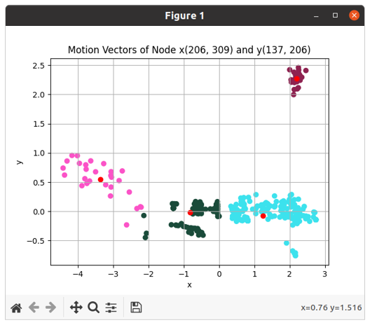
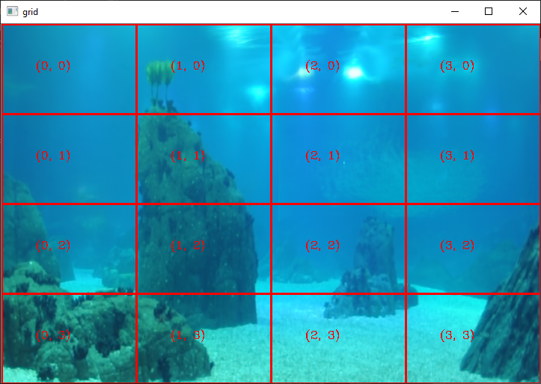

Anomaly Detection - Switching Vector Model
Model a set of trajectories by a set of vector fields.
Parameters: number of nodes, number of fields, $δ and α$ (neighborhood distance/attenuation)
Motion vectors initialization: KMeans
Model training: EM algorithm
How close a new trajectory is modeled by these fields? Complete log likelihood

Slide 14
Feeding - Motion Variability

Slide 15
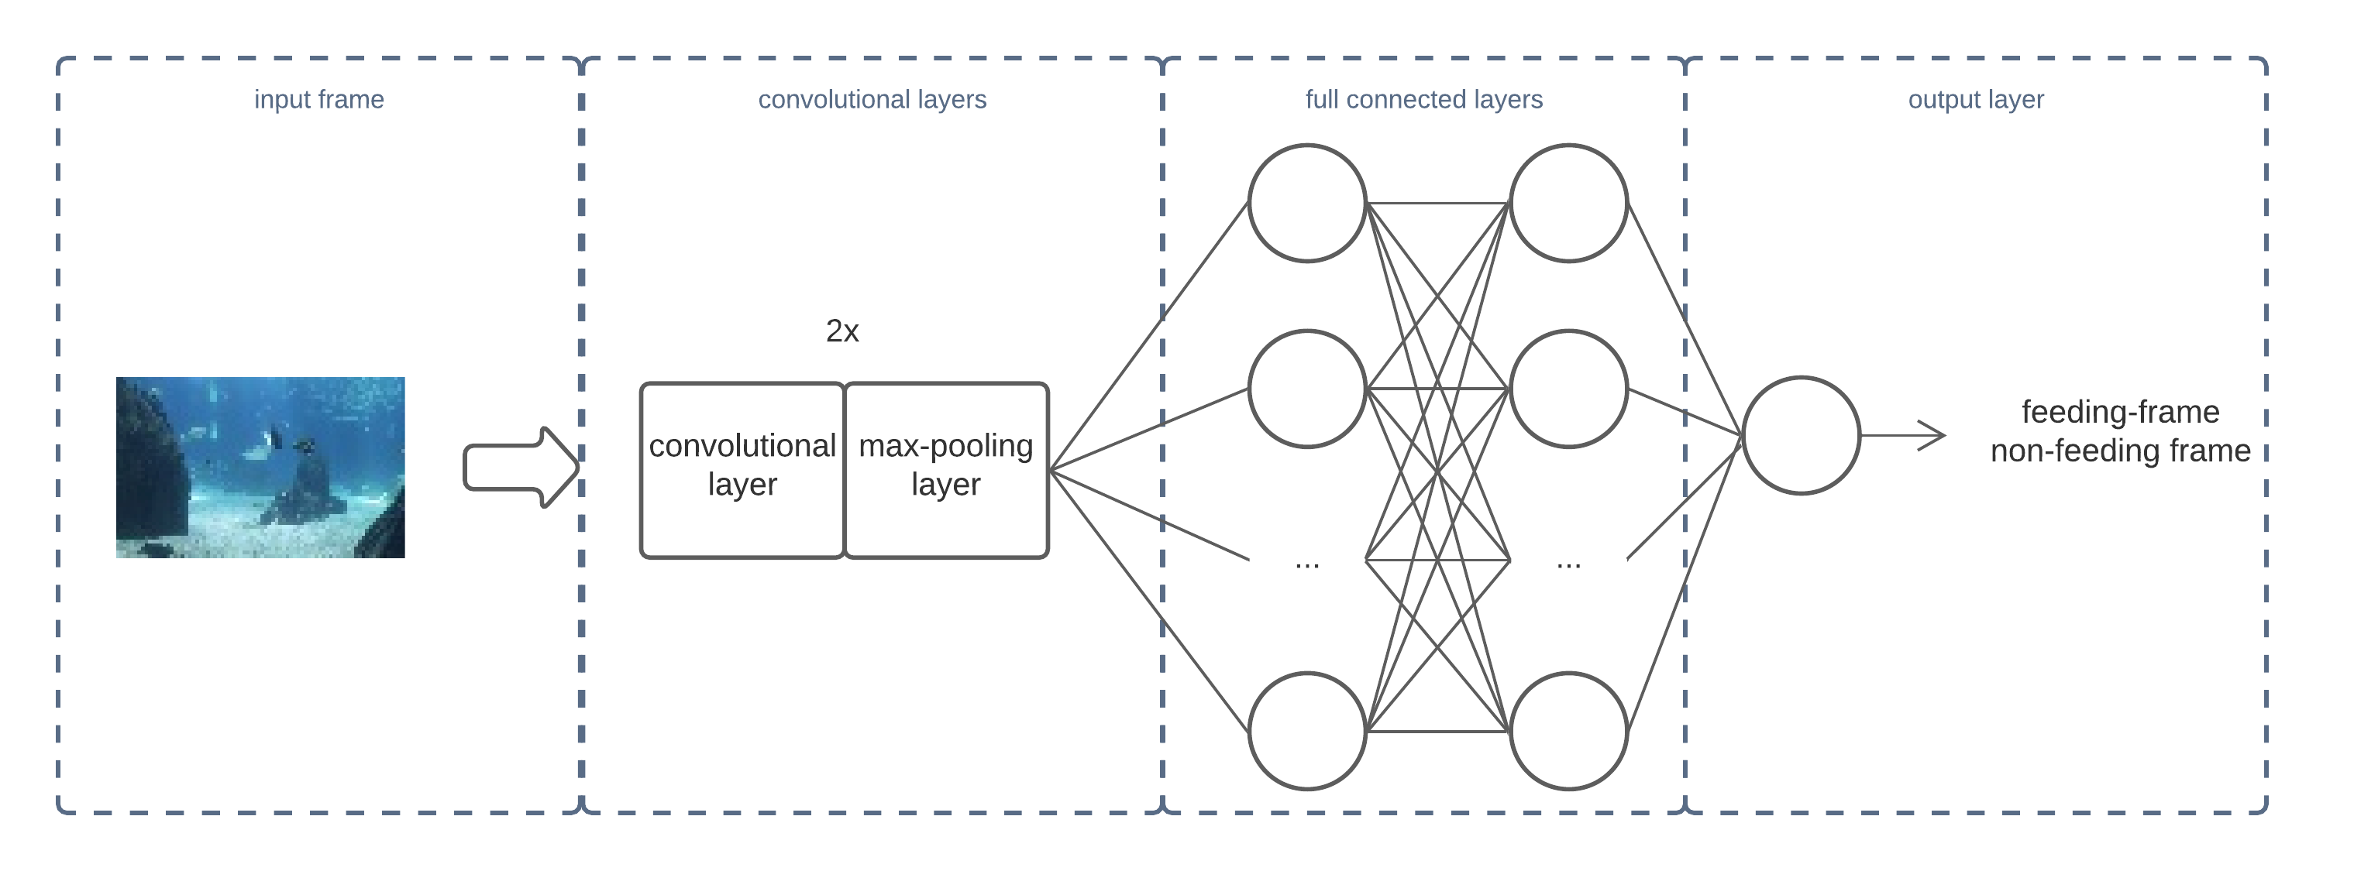
Feeding - CNN
Grid search
Architecture parameters: convolutional/FC layers, neurons per layer, number of filters
Hyper-parameters: learning rate, dropout rate, activation function, loss function

Slide 16
Feeding - Aggregation Index
Delaunay Triangulation

Slide 17
Results

Slide 18
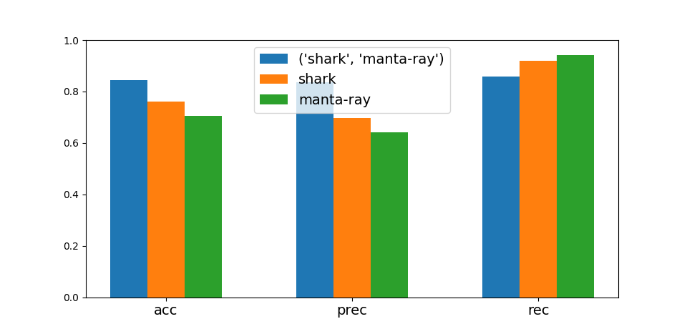
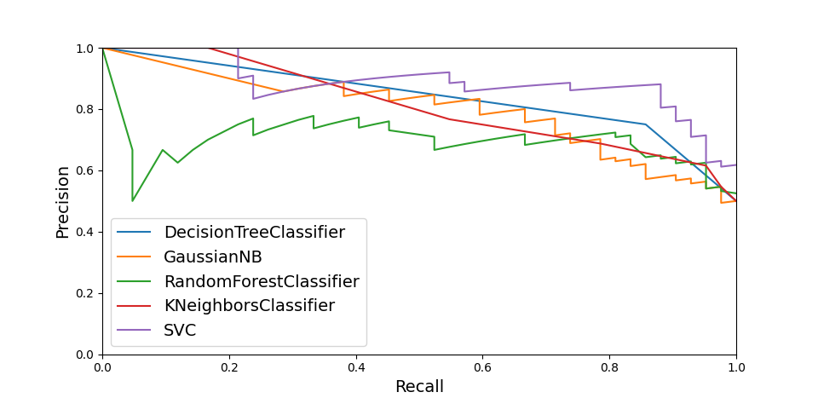
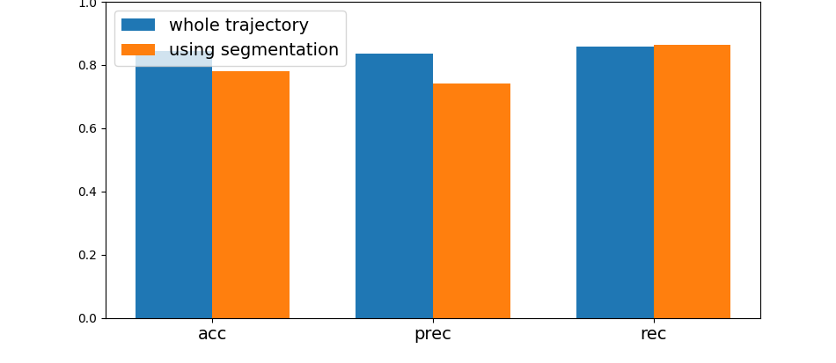
Interesting Episodes Detection
Multiple Model
Models' comparison
Segmentation Impact
Model | AUC
SVM | 0.89
KNN | 0.81
NB | 0.8
DT | 0.84
RF | 0.7
Switching Vector Model
Class | Accuracy
Normal | 17/42 (40%)
Interesting | 24/29 (83%)
Both | 41/71 (58%)

Slide 19
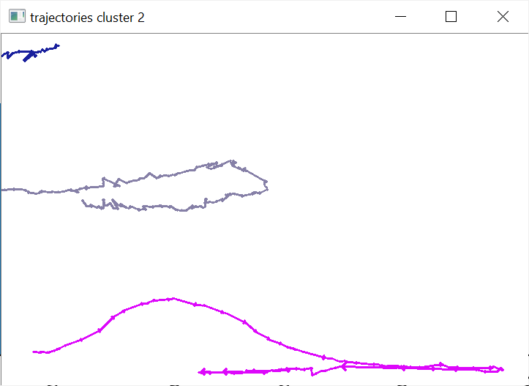
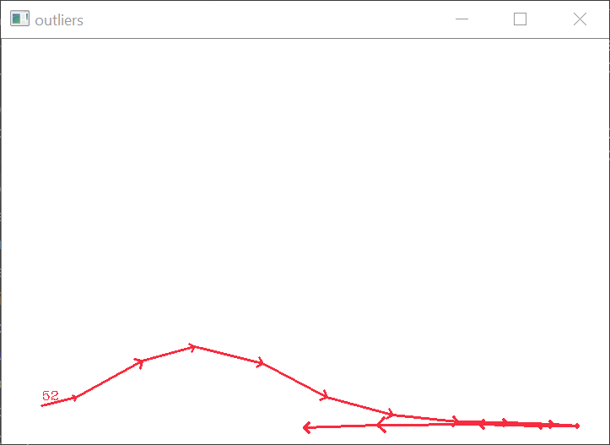
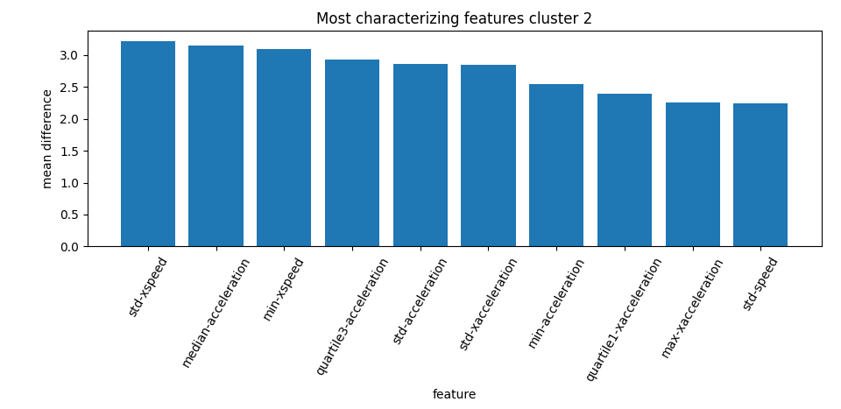
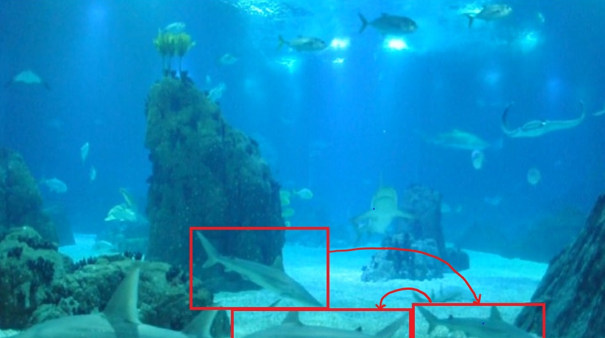
Kmeans
Silhouette=0.3
Anomaly Detection
DBScan
Silhouette=0.72

Slide 20
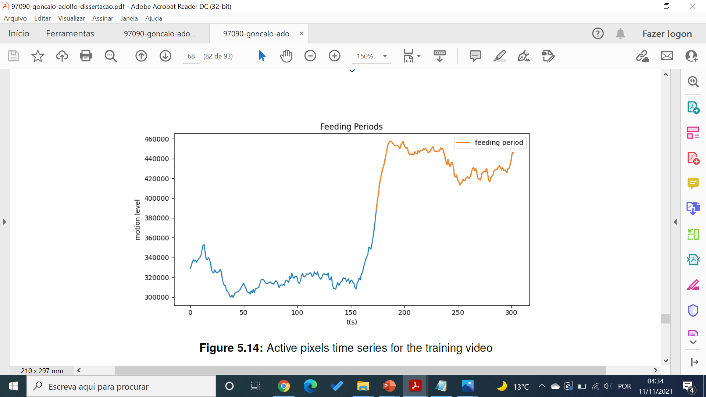
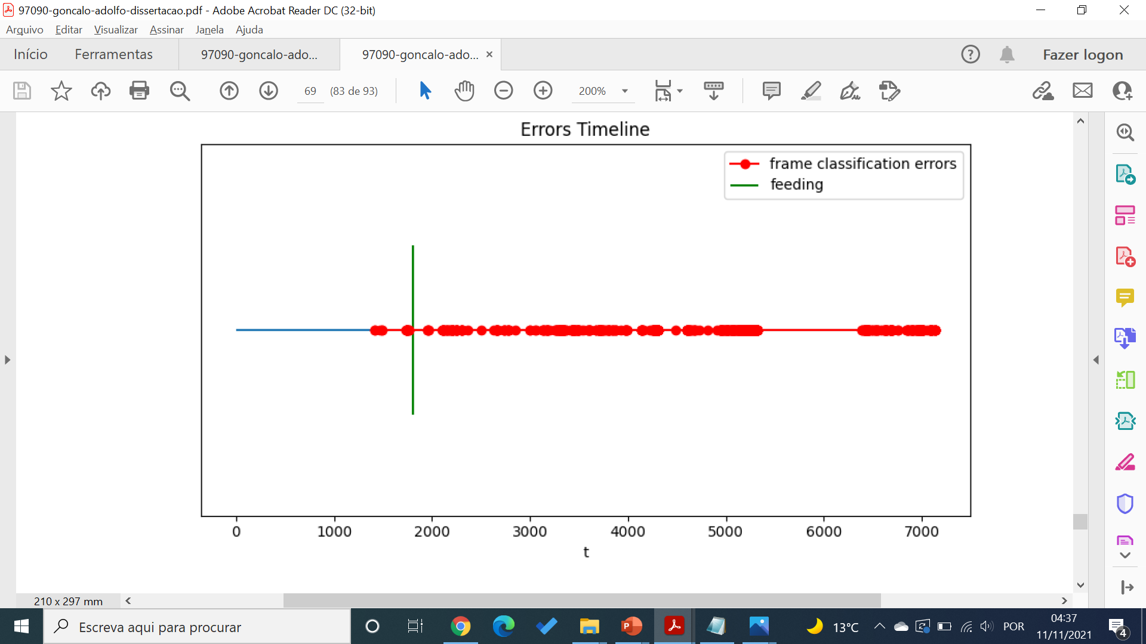
Feeding Detection
Method | Accuracy | Precision | Recall
CNN | 0.90 | 0.95 | 0.87
Active pixels | 0.96 | 1 | 0.94
Optical flow | 0.4 | 0.65 | 0.05
Active pixels (using region) | 0.96 | 1 | 0.94
Optical flow (using region) | 0.4 | 0.7 | 0.06
CNN using go pro dataset | 0.27 | 0.28 | 0.86

Slide 21
Conclusions
Real time visual inspection is time consuming
Help biologists monitoring tanks
1
System capable of detecting interesting episodes, anomalies and feeding periods
Using: video frames and fish trajectories
2
Density-based clustering approach seems more appropriate for anomaly detection task (0.72 silhouette)
Interesting episodes detection task round the 80% of accuracy
Feeding detection achieved the excellent range (96%)
3
Useful future work:
Big data trajectories dataset colection
Decrease image plane dependency
Understand CNN results (image regions)
Application to be used by the end users (biologists)
4

